Slide 1
EUROFARMS AGRO-B s.r.o.

Slide 2
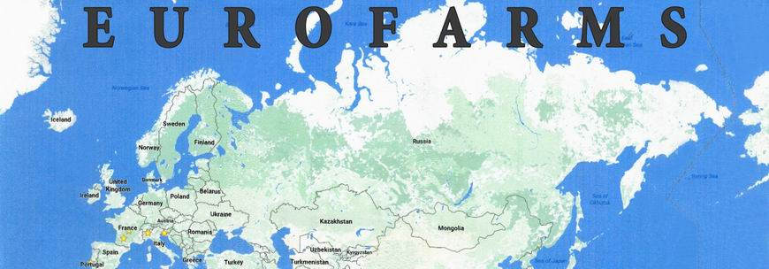
EUROFARMS WORLDWIDE
Eurofarms - France, Ukraine, Serbia, Romania, Hungary, Portugal and Spain
Different management
Type of farming

Slide 3
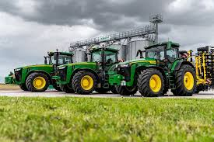
EUROFARMS IN Czech republic
6 regional agricultural companies
25 thousand hectares
Plant production
Animal production

Slide 4
EUROFARMS IN Czech republic
specific types of cereals, oilcrops
Seed multiplication
Production of dairy and meat products
Production of feed for cattle
Growing crops

Slide 5
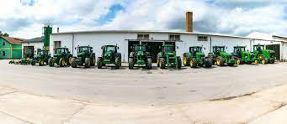
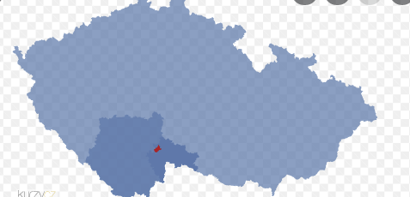
KARDAŠOVA ŘEČICE
Established in 1267
Emblem and flag
Little town
Czech republic
15 kilometers away from Jindřichův Hradec
Population: 2 237 (2022)
Area: 46 km²

Slide 6
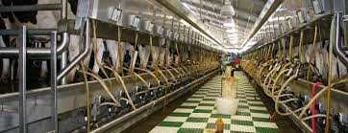
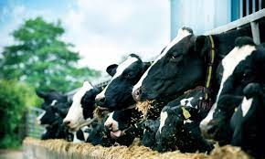
ANIMALS PRODUCTION
Milk cows (dairy cows)
40 000 litre/day
1670 head of cattle
Second part of animal production: Breeding pigs

Slide 7
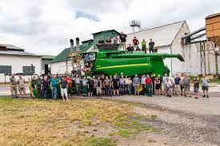
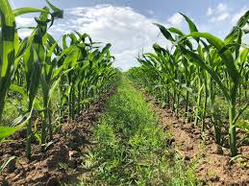
PLANT PRODUCTION
Rent fields (more than thousands contracts)
Grow: cereal and oil plant
Winter: barley, oilseed rape, wheat, oat, rye
Spring: Barley, Wheat, Corn to silage, Corn
Seedling: potato seedling, sugar beet

Slide 8
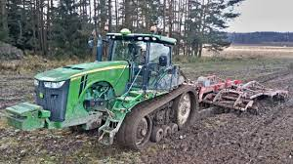
MECHANIZATION
Special system of working with 9 or 4.5 meters
Larger machines are also used
Mostly used is John Deere
The wheelbase is 2.25

Slide 9
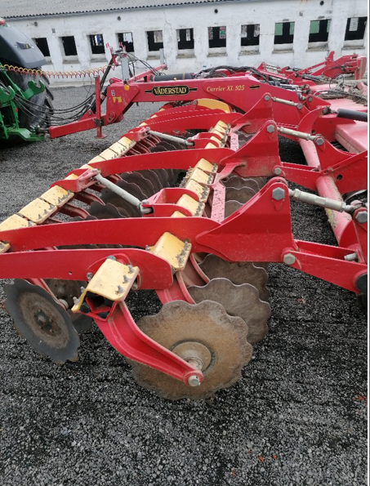
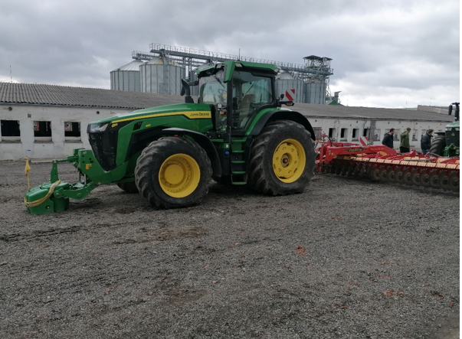
MECHANIZATION
Cultivator
John Deere 8410R and disk cultivator Väderstad carrier XL 925

Slide 10
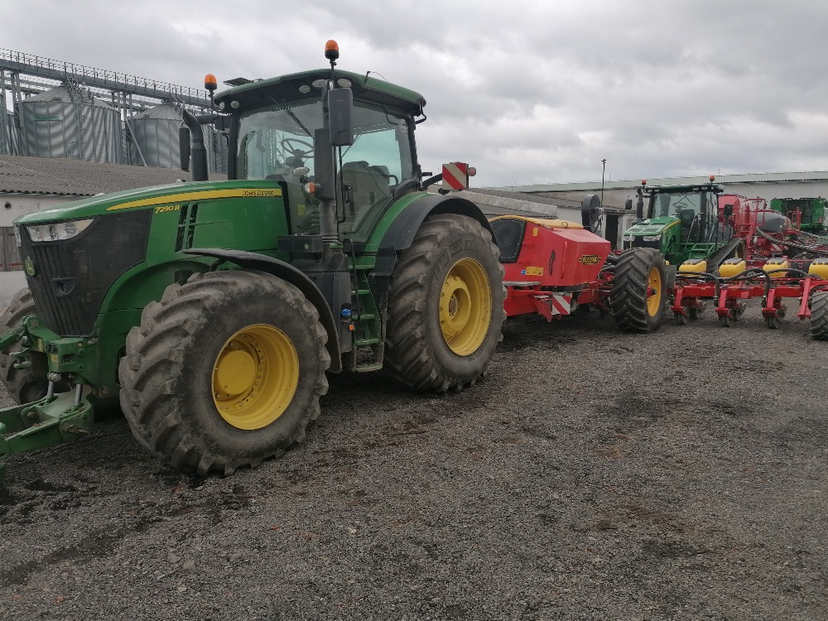
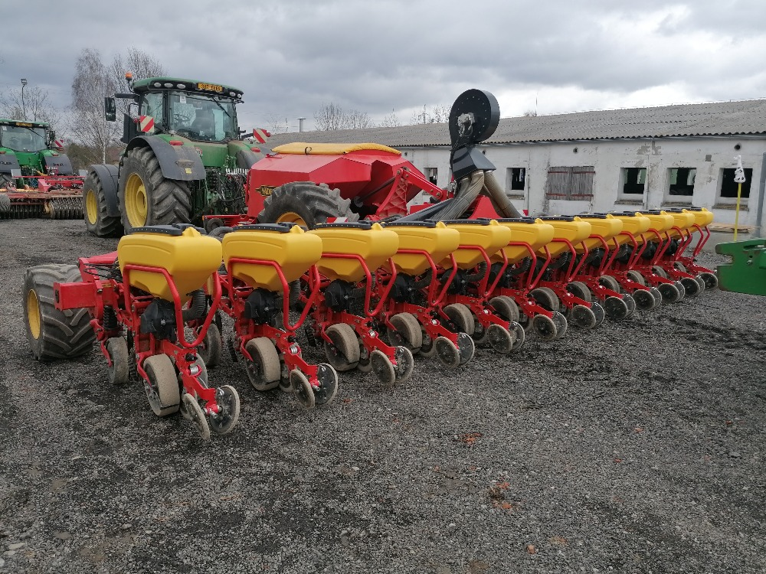
MECHANIZATION
Corn planter
John Deere 7290R and cornplanter Väderstand tempo L12

Slide 11
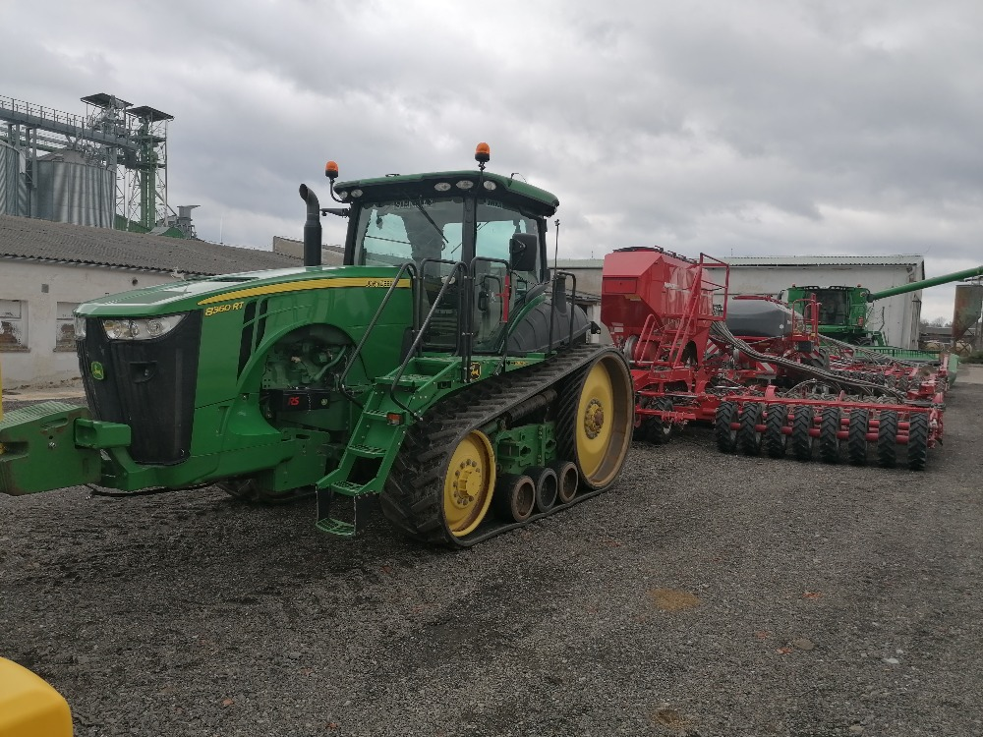
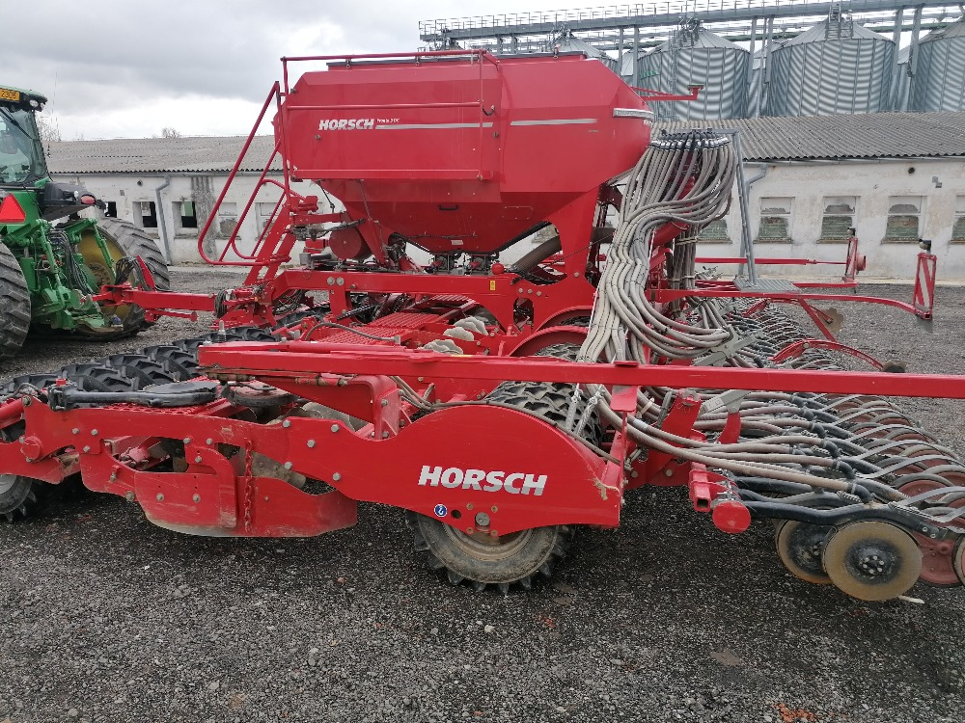
MECHANIZATION
Seed drill
John Deere 8360RT and seeder Horsch Pronto 9DC

Slide 12
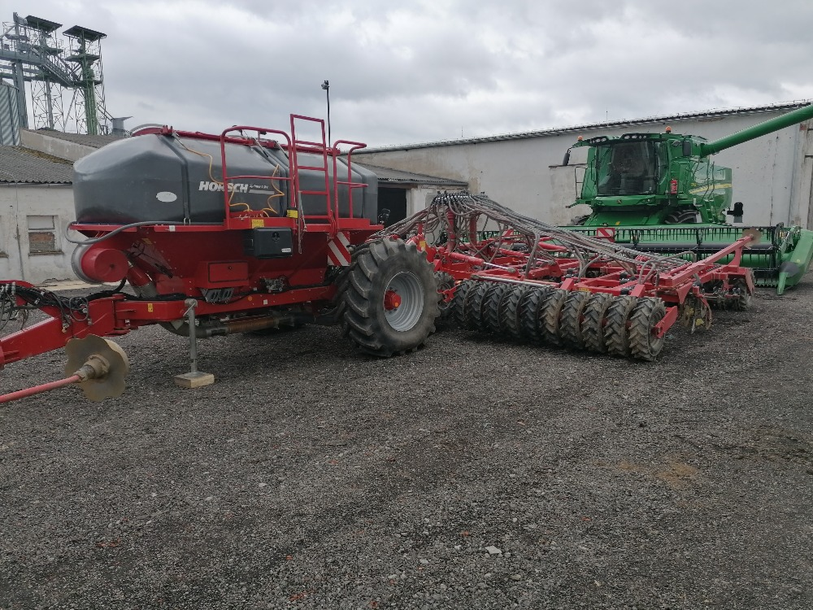
MECHANIZATION
Tine seed drill
Horsch Sprinter 9SW

Slide 13
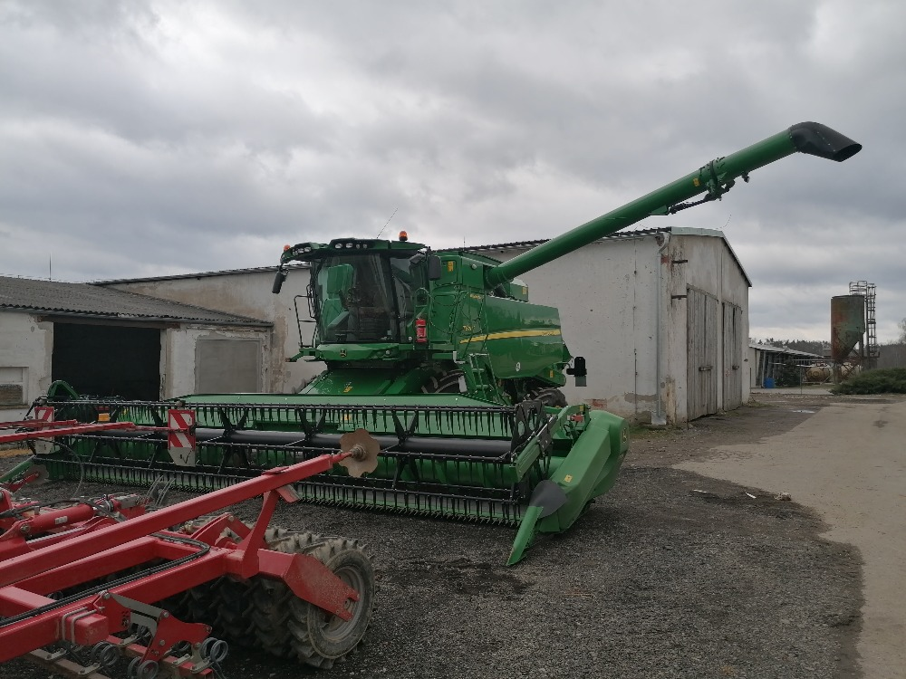
MECHANIZATION
Combine Harvestor
John Deere T670i

Slide 14
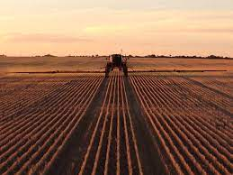
CTF - Controlled Traffic Farming
controlled operation
easy way to reduce input costs and many crossing damage
overall approach of farms, based on high technological discipline
consistent changes in the organization of machine rides

Slide 15
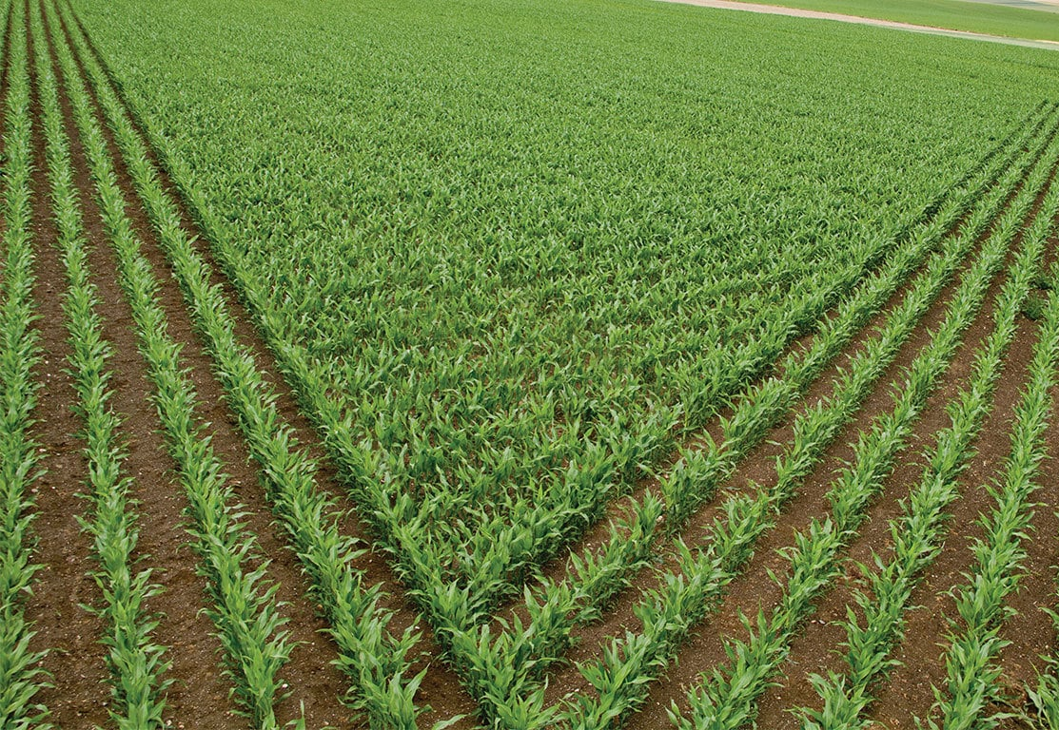
GPS
necessary for the CTF system
use full version navigation systems
mainly for precision execution of work
fast and accurate results of their work

Slide 16
Thank you for your attention

